Slide 1
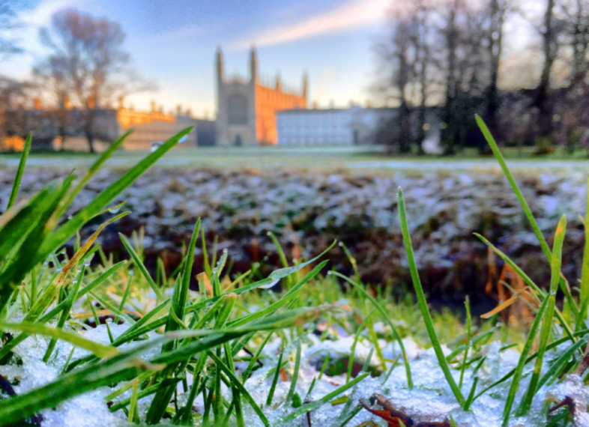
ACADEMIC UNIVERSITY FINANCES
CURRENT NARRATIVE
Knowledge Bites
David Hughes, Director of Finance

Slide 2


OBJECTIVES OF THIS PRESENTATION
To outline:
The Academic University’s financial drivers;
The journey we were on pre pandemic;
How we have weathered the storm (so far); and hence
The current financial narrative as we head into 2021/22
2
Finance Division

Slide 3

WHAT WE MEAN BY ‘THE ACADEMIC UNIVERSITY’?
THE COLLEGIATE UNIVERSITY
THE ACADEMIC UNIVERSITY (‘LITTLE U’)
THE UNIVERSITY GROUP (‘BIG U’ )
Research & Teaching:
Schools, Departments, Non-School Institutions
Cambridge
University Press
Cambridge
Assessment
31 independent affiliated Colleges
Trusts
CE
CUTS
Portal
IfM
CISL
CA Subsidiaries
CUP Subsidiaries
Subsidiary companies, joint ventures, and Associated Trusts
3
Finance Division
Finance Division

Slide 4

ACADEMIC UNIVERSITY FINANCIAL DRIVERS
4
Finance Division
Finance Division

Slide 5
ACADEMIC UNIVERSITY FINANCIAL DRIVERS
Maximise impact not profit
Invest in people & estate to stay competitive
Capital investment funded by donations, grants, CUP/CA & unrestricted reserves
CUEF cross-subsidises loss making activities
Financial balancing act to maintain
To be sustainable, must match costs and revenues over time with surplus for renewal & replacement
5
Finance Division
Finance Division

Slide 6
ACADEMIC UNIVERSITY FINANCIAL DRIVERS
Maximise impact not profit
Invest in people & estate to stay competitive
Capital investment funded by donations, grants, CUP/CA & unrestricted reserves
CUEF cross-subsidises loss making activities
Financial balancing act to maintain
To be sustainable, must match costs and revenues over time with surplus for renewal & replacement
Growth in non-fully-funded research, and cost growth ahead of revenues; we have started to budget net operating cash flow deficit
With high capex on projects, central, liquid funds could become exhausted
6
Finance Division
Finance Division

Slide 7
ACADEMIC UNIVERSITY FINANCIAL DRIVERS
Maximise impact not profit
Invest in people & estate to stay competitive
Capital investment funded by donations, grants, CUP/CA & unrestricted reserves
CUEF cross-subsidises loss making activities
Diversified revenues & strong B/S allow us to manage risk better than most
Financial balancing act to maintain
To be sustainable, must match costs and revenues over time with surplus for renewal & replacement
Targeting short and long term actions to improve position
Growth in non-fully-funded research, and cost growth ahead of revenues; we have started to budget net operating cash flow deficit
Bond proceeds invested in revenue generating projects (non-op. estate), creates incremental value back for core mission
With high capex on projects, central, liquid funds could become exhausted
It’s a complex picture!
7
Finance Division
Finance Division

Slide 8
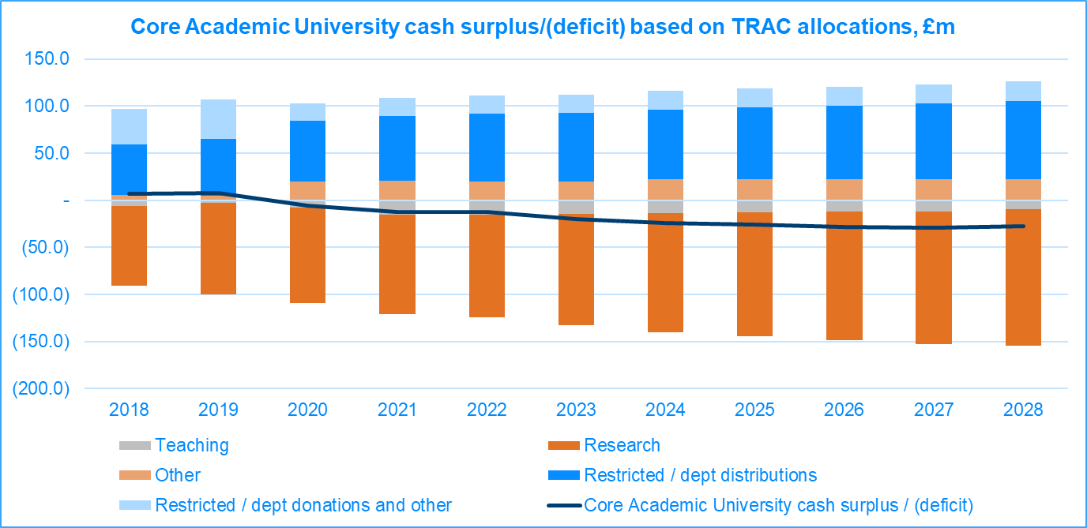
THE CASH FLOW BALANCING ACT
8
Finance Division
Finance Division
Notes:
BUILDING ON THE PICTURE I SHARED LAST YEAR – HERE WAS OUR TEN YEAR MODEL
BARS ARE APPROXITE CASH FLOW CONTRIBUTION FROM ACTIVITIES AND SHOW THE CROSS SUBSTITUTION FROM CUEF
BLACK LINE IS THE AGGREGATE BALANCE - I FINELY BALANCED AND DIPPING INTO A DEFICIT
LATEST MODEL UPDATE IS BETTER – DEPENDENT ON COVID RECOVERY INITIATIVES AND ASSUMPTIONS AROUND FUTURE INTERNATIONAL STUDENT NUMBERS AND FEES ETC.

Slide 9

ACHIEVING A SUSTAINABLE SURPLUS
Short-term responses:
  Deliver committed Budget savings
  Capital programme prioritisation / pause
  Balance timing of commitments / mitigation of risk
  Plus COVID-19 emergency measures
9
Finance Division
Finance Division

Slide 10

ACHIEVING A SUSTAINABLE SURPLUS
Mid-term “Category 2” initiatives:
  Increasing income: Size & Shape etc.
  Driving efficiencies: Educational space; Procurement & Purchasing; Transparency & Budgeting; Research recoveries; Reimagining Professional Services; etc.
  RECOVERY PROGRAMME
Short-term responses:
  Deliver committed Budget savings
  Capital programme prioritisation / pause
  Balance timing of commitments / mitigation of risk
  Plus COVID emergency measures
10
Finance Division
Finance Division

Slide 11
ACHIEVING A SUSTAINABLE SURPLUS
Big U support over long-term:
  Additional funds from rebuilt CUP / CA surpluses
  Increased / aligned philanthropy
  Sales of illiquid assets
  Revenue from Bond funded projects (non-operational estate)
Mid-term “Category 2” initiatives:
  Increasing income: Size & Shape etc.
  Driving efficiencies: Educational space; Procurement & Purchasing; Transparency & Budgeting; Research recoveries; Reimagining Professional Services; etc.
  RECOVERY PROGRAMME
Short-term responses:
  Deliver committed Budget savings
  Capital programme prioritisation / pause
  Balance timing of commitments / mitigation of risk
  Plus COVID emergency measures
11
Finance Division
Finance Division

Slide 12

COVID-19 - THE CURRENT FINANCIAL NARRATIVE
Academic University weathered COVID better than expected
Revenue did not fall in the way we feared
Additional costs were not as large as predicted
CA / CUP downturn; expected surplus in 2 years to July 2021 down £200m
  Good progress on merger and ambitious strategy
  Too early to count on return of high surplus
Material risks remain:
  Economic and mobility uncertainties - repeated waves / Geo-political concerns
  HMG significant deficit; response to Augar
  Markets remain high; risk to CUEF returns
  USS costs and risk of industrial action
12
Finance Division

Slide 13
COVID-19 - THE CURRENT FINANCIAL NARRATIVE
Significant investments to compete: academic capabilities, estate & zero carbon
CA/CUP competitive market; merger allows development & greater profitability spread
  We cannot rely on CA/CUP to deliver all funds needed for investment
Academic University needs to make surplus for reinvestment; philanthropy must be targeted
Recovery Programme - has started to make progress, targeting revenue gains and efficiency savings:
  Enhanced revenues (size and shape)
  Procurement and Purchasing
  5% savings in administrative costs over 3+ years (turnover of 15% pre-pandemic)
  New financial system and new budget model in development to align incentives and provide information to make better decisions
Until these bear fruit, limited further resource available for investment
But, based on what we know, no need to continue ‘emergency restrictions’
13
Finance Division

Slide 14
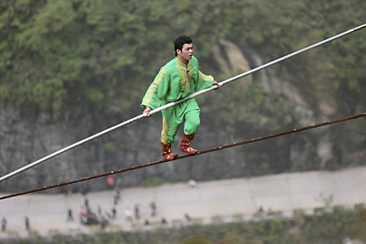
OUR CURRENT FINANCIAL NARRATIVE
As far as we know, we have avoided worst of COVID-19 risk
So emergency measures taken last year can be substantially reversed
We must focus with renewed vigour on opportunities to generate a sustainable surplus to allow investment without over-reliance on CUP/CA
14
Finance Division

